Slide 1
Intercultural Learning A workshop for graduate students Aletha Stahl, PhD Senior Intercultural Learning Specialist Heather Offerman, PhD Candidate Intercultural Learning Graduate Assistant

Slide 2
Introductions

Slide 3
Handout – What is the difference between multicultural, intercultural and cross-cultural?
What are some ideas before you read?
Read the handout quickly with a partner
What are examples of each?

Slide 4
Handout – What is Intercutlural Learning?
How does this handout define intercultural learning?
What are some skills one possesses for having an intercultural learning mindset?
Is there anything that surprised you about the definition, skills, anything in general?

Slide 5
AAC&U RUBRIC

Slide 6
Voices from the Past (handout)

Slide 7
Voices from the Past (handout)
Debrief
What do you notice about the messages people shared?
Any surprises in what people chose to share?
How is this introduction different from what you normally get in an introduction? What impact did these differences have?

Slide 8
https://www.youtube.com/watch?v=Z9flOzmpShI

Slide 9
Debrief
What happened in this video?
How do you feel after watching it?
What did you learn?
How does this connect to your daily life?
What next?

Slide 10
How Rude Was That?
In small groups, discuss if you find the following to be rude:
1. Avoiding eye contact during a conversation
2. Arriving late for a meeting with no explanation
3. Burping at the end of a meal
4. Asking why someone doesn’t have children

Slide 11
Debrief
If you found something rude, how might it affect your perception of a person? How might it affect how you communicate with them?
Who/What determines rules for politeness? Where do we learn these rules?

Slide 12
What Does a Behavior Mean?
Fill out the first worksheet, then the second.

Slide 13
Debrief
How was it to imagine interpretations?
What scenarios did you imagine?
What values are reflected by your interpretations?
What did you learn?
How will you apply what you learned?

Slide 14
Four Analogies
Drawn from an activity by Kate Berardo
Berado, K. (2012). Four analogies. In In K. Berardo & D. K. Deardorff (Eds.), Building cultural competence: Innovative activities and models (pp. 61-68). Sterling, VA: Stylus Publishing.
How is culture like a/an…

Slide 15
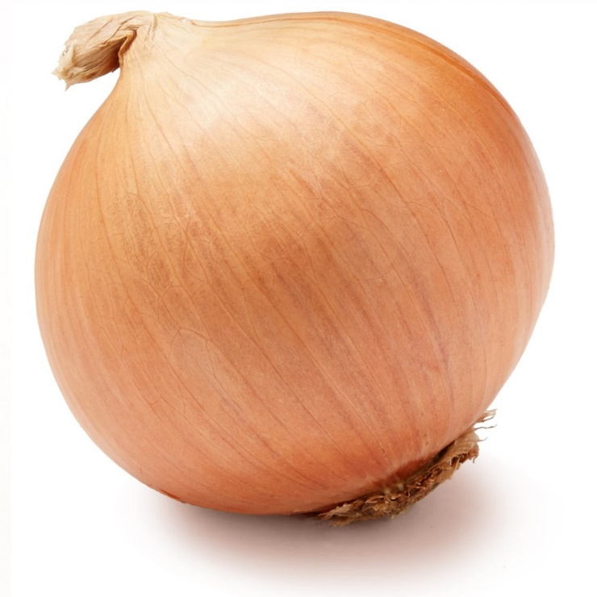
Benefits
Emphasizes the complexity of human identity
Illustrates that some layers/aspects of identity are closer to the surface or more visible than others
Drawbacks
Depicts layers are separate from each other rather than intersecting
Implies that revealing cultural identity is destructive to the self (peeling back layers)
…Onion?
Notes:
According to Berardo (2012): “Like an onion, people are shaped by many layers of culture: national culture, regional culture, organizational culture, and many other types of culture (gender, religion, family, etc.)” (p. 62).
When we focus on only one layer, we can fall back on ideas of “us” vs. “them.” This also reduces a person to a single layer and not a complex being (p. 62).
Benefits of thinking of culture like an onion include emphasizing the complexity of human identity (many cultural layers) and understanding that some layers/aspects of identity are closer to the surface or more visible than others.
Drawbacks to this analogy include the implication that layers are separate from each other (not intersecting, as they are in reality) and the idea that peeling back layers is destructive to the self

Slide 16
Benefits
Emphasizes how culture can constrain our perceptions and experiences
Shows how we can’t see these constraints until we jump outside the fishbowl to another environment or perspective
Drawbacks
Shows an individual in an inanimate environment, neither of which is accurate
Depicts culture as having rigid, non-porous boundaries (except the escape hatch)
…Fishbowl?
Notes:
According to Berardo (2012): “Like water to a fish, the influence of our own culture is often invisible to us: It is simply what we know and what we depend on for survival” (p. 62).
When we become like a “fish out of water,” then we can start to recognize our culture and our dependency on it (Berardo, 2012, p. 62).
Benefits of thinking about culture as like a fishbowl include the way it can constrain our thinking, and that we can’t even see those constraints until we jump out of our fishbowl into another environment.
Drawbacks include the framing of an individual fish solo in an environment that is inanimate and static, and the idea of cultural boundaries being rigid and non-porous.

Slide 17
Benefits
Demonstrates that much of culture is hidden below the surface
Illustrates that the unknown aspects of deep culture is what presents danger/risk in terms of miscommunication or misunderstanding by outsiders
Drawbacks
Depicts culture as a monolithic whole (homogeneous, or the same for all members), which is a dangerous assumption
Implies that culture is solid – static and unchanging over time, which is not true
…Iceberg?
Notes:
Culture is also like an iceberg: there are elements that are visible above the water and hidden elements below the water. These hidden elements represent the deeper, often invisible, elements of culture. By focusing only on the visible, we miss important pieces and can easily stereotype a culture. However, it is more difficult to adapt to these deeper elements (Berardo, 2012, p. 62).
Benefits of thinking about culture like an iceberg include the understanding that most of culture is hidden, and that the hidden part is what presents a danger to miscommunication (like hidden ice to ships).
Drawbacks include thinking about culture as monolithic (all the same for everyone in the culture) and solid (static, unchanging).

Slide 18
Notes:
You may have seen this representation of the concept of culture before. Both CILMAR and SLC care deeply about all levels. They also focus on these in somewhat different ways.
http://www.homeofbob.com/literature/esl/icebergModelCulture.html

Slide 19
Benefits
Emphasizes how culture can shape our perceptions and experiences
Illustrates that we can consciously choose to change our perceptions (by removing or changing glasses)
Drawbacks
Implies that we can be “objective” if we just remove the glasses that are distorting our vision
Suggests that escaping cultural biases is as easy as taking off one’s glasses
…Lenses?
Notes:
According to Berardo (2012), since all “culture is a system for making meaning of things, and as a result, we all wear cultural lens or filters when we interpret a situation” (p. 62).
Like the fish out of water, we have to work to recognize our own lenses (Berardo, 2012, p. 62).
Benefits of thinking about culture as a pair of lenses include the idea that it shapes our perceptions and experiences, and the concept that we are not trapped by these perceptions (we can take off the glasses).
Drawbacks include thinking that we are objective without the lenses, and that it is easy to escape our cultural biases by removing the lenses.

Slide 20
Other Metaphors for “Culture”
Drawn from materials by Jennifer E. Beer
Beer, J. E. (1997-2003). A picture is worth a thousand words… Metaphors for “culture.” Culture at Work. Retrieved from http://www.culture-at-work.com/concept2.html
Why do people think of culture in these ways?
How does each enable and constrain our understanding of culture?
Notes:
Place learners into groups to discuss these additional metaphors with the prompts above.

Slide 21
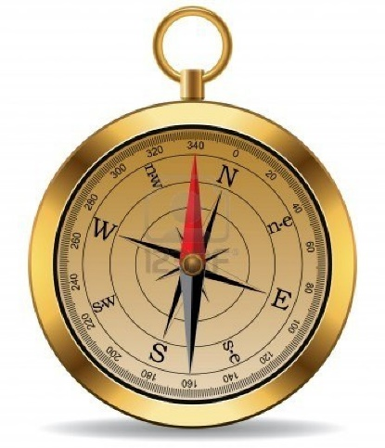
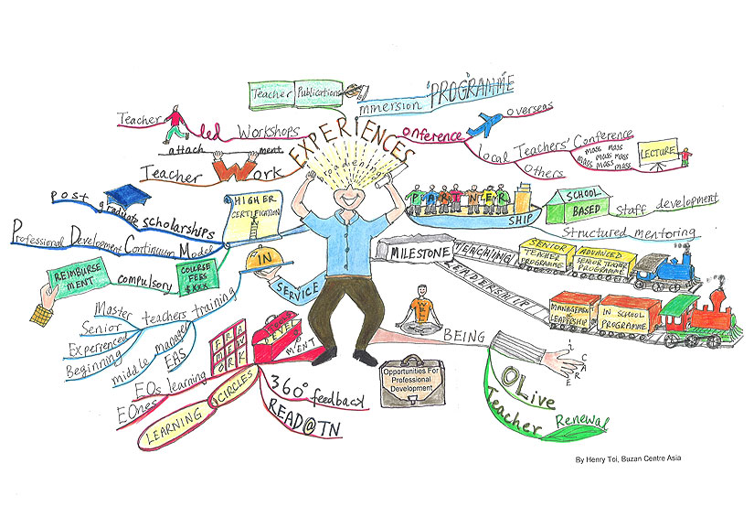
Force Field
Compass
Mind Map
Organism
Chaos
Software
Notes:
According to Jennifer E. Beer (1997-2003), force fields are invisible but “unifying and powerful.” This suggests that culture is dynamic and “beyond individual control” (n.p.)

Slide 22
Final Reflection
What did you learn in this workshop?
How would you describe intercultural learning and why it matters to your peers? To your advisor or research director?
How will you apply what you learned?

Slide 23
AAC&U RUBRIC
When you did X activity, where would you place yourself on the activity?

